Slide 1
Data Science & Sharing Team NIMH IRP Investigator’s Seminar Series 12 March 2019
Adam Thomas
Data Science and Sharing Team, FMRIF, NIMH
http://cmn.nimh.nih.gov/dsst
adamt@nih.gov Slides available online: https://github.com/agt24

Slide 2
Questions
Why do we need a Data Science & Sharing Team?
What does the Data Science & Sharing Team do?
How can you make your science more reproducible?

Slide 3
Questions
Why do we need a Data Science & Sharing Team?
What does the Data Science & Sharing Team do?
How can you make your science more reproducible?

Slide 4
Why do we need a Data Science & Sharing Team?
The DSST was created in 2016 by Susan Amara and Peter Bandettini to address a growing data problems within the IRP
Notes:
This stuff is really important and super boring. It’s not what you got a PhD for and we can help you.

Slide 5
Problem #1: Scientist are downing in data
Notes:
This stuff is really important and super boring. It’s not what you got a PhD for and we can help you.

Slide 6
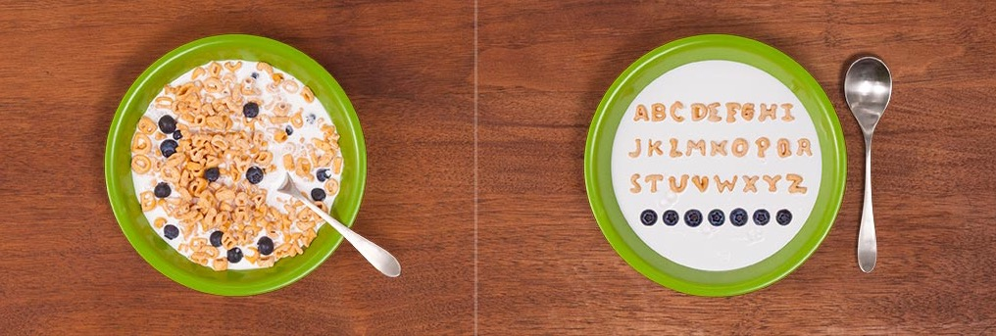
Problem #1: Drowning in data
“How much time do you spend handling, reorganizing, and managing your data as opposed to actually doing science?”
Median answer is 80%

Slide 7
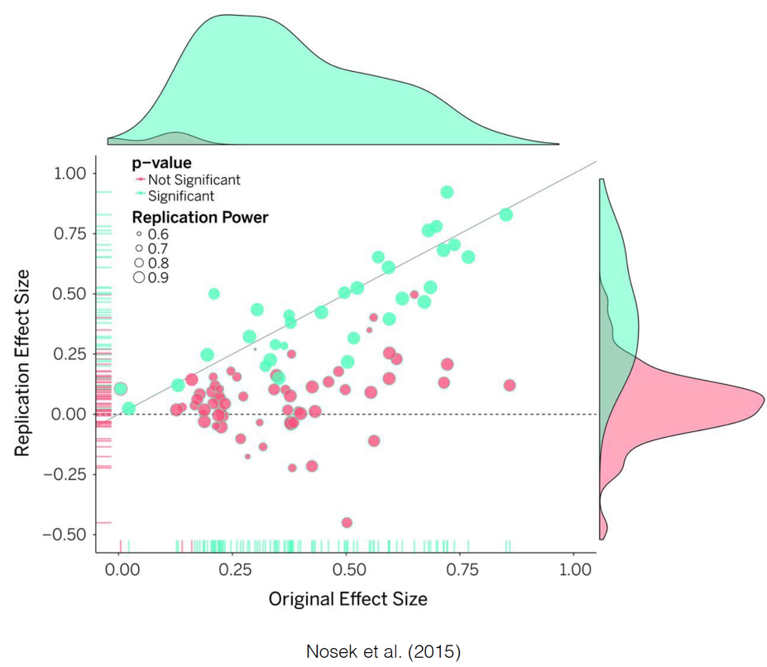
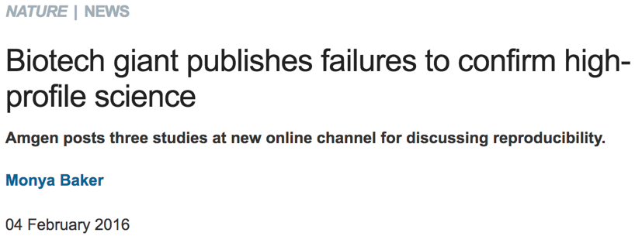
Problem #2: Reproducibility

Slide 8
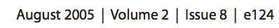
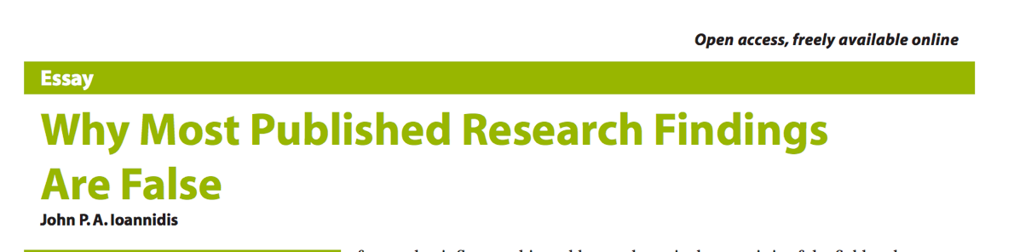

Problem: Reproducibility
The Reproducibility Crisis dates back to 2005
Notes:
This stuff is really important and super boring. It’s not what you got a PhD for and we can help you.

Slide 9
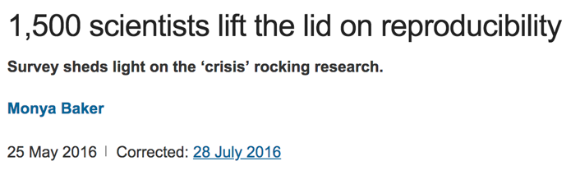
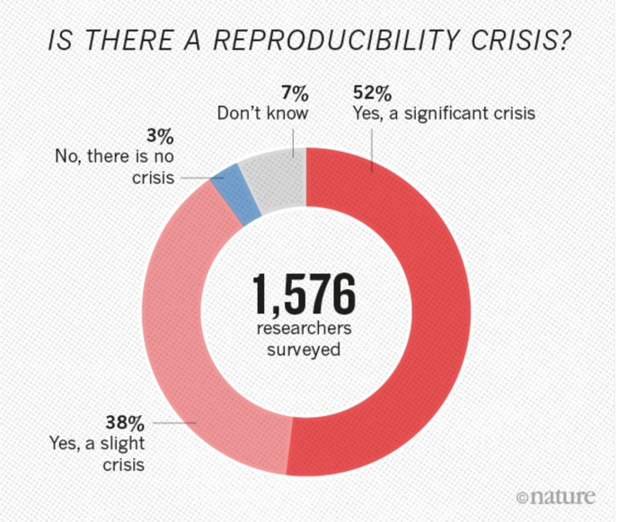
Problem: Reproducibility
The Reproducibility Crisis date back to 2005
Surveys suggest consensus the problem is real
Notes:
This stuff is really important and super boring. It’s not what you got a PhD for and we can help you.

Slide 10
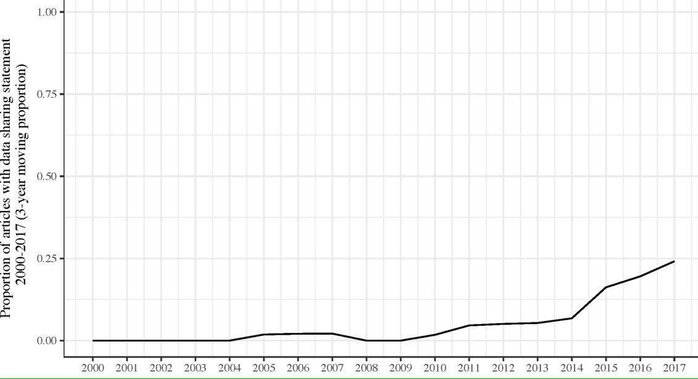
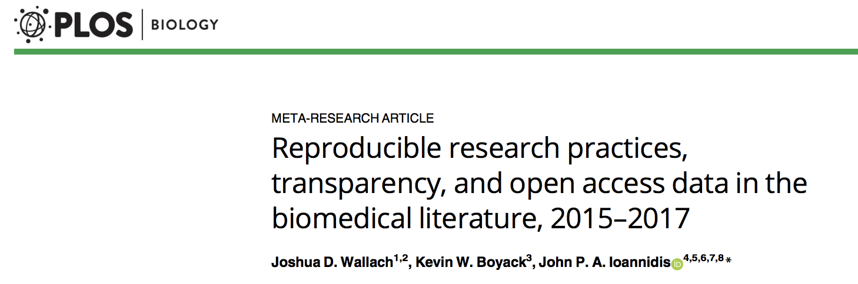
Problem: Reproducibility
The Reproducibility Crisis dates to 2005
Surveys suggest consensus
Signs of improvement
Notes:
This stuff is really important and super boring. It’s not what you got a PhD for and we can help you.

Slide 11
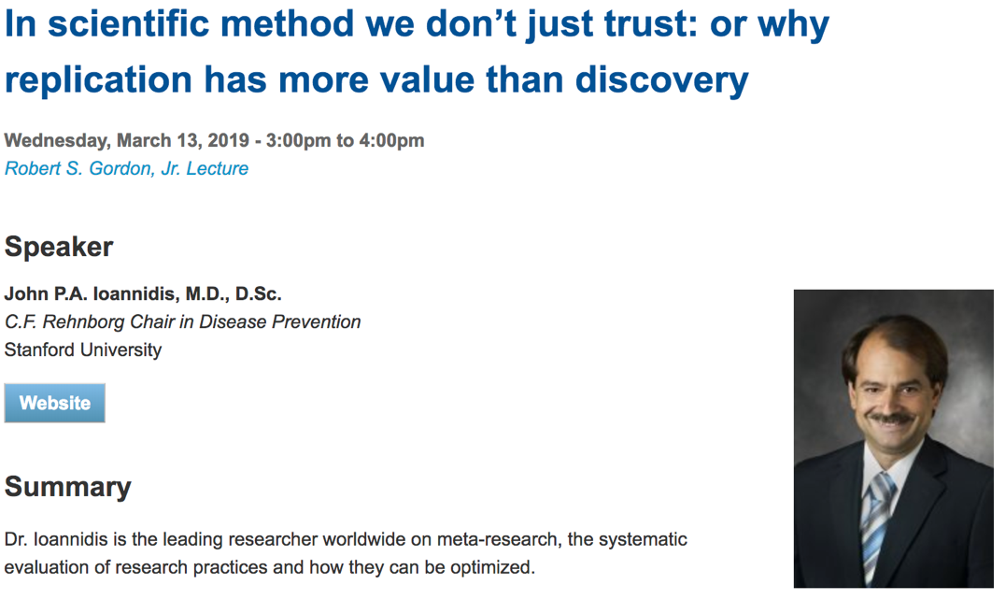
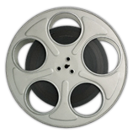
Problem: Reproducibility
The Reproducibility Crisis dates to 2005
Surveys suggest consensus
Signs of improvement
Notes:
This stuff is really important and super boring. It’s not what you got a PhD for and we can help you.

Slide 12

Problem: Reproducibility
NIMH strongly encourages investigators to use a standard set of common data elements, when available […]. In addition, NIMH expects investigators to share data and biospecimens through the appropriate databases and repositories […]” https://www.nimh.nih.gov/about/strategic-planning-reports/strategic-research-priorities
Notes:
This stuff is really important and super boring. It’s not what you got a PhD for and we can help you.

Slide 13

Problem: Reproducibility
https://www.nih.gov/news-events/news-releases/nih-releases-strategic-plan-data-science
Notes:
This stuff is really important and super boring. It’s not what you got a PhD for and we can help you.

Slide 14
Questions
Why do we need a Data Science & Sharing Team?
Science in the IRP can and should be more reproducible, and we’re making progress
Data management is slowing the progress of research
What does the Data Science & Sharing Team do?
How can you make your science more reproducible?

Slide 15
Here to help
The NIMH IRP Computational Support Group
Scientific Information Officer
Data Science & Sharing Team
Machine Learning Team
Francisco Pereira
Co-located in the D wing on the 3rd floor of building 10
Frequent meetings and communication to route issues appropriately

Slide 16
Questions
Why do we need a Data Science & Sharing Team?
What does the Data Science & Sharing Team do?
Sharing & Curating data
Training
Collaborative projects and grants
How can you make your science more reproducible?

Slide 17
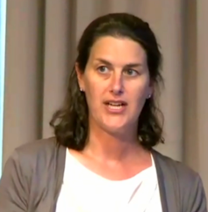
Sharing Data
IRP Datasets shared: Gonzalez-Castillo et al., 2012, https://doi.org/10.15154/1464517 Gonzalez-Castillo et al., 2015, https://doi.org/10.15154/1464520 Shaw et al., 2018, https://doi.org/10.15154/1463004 Thurm et al., 2018, https://doi.org/10.15154/1464602 Power et al., 2018, https://openneuro.org/datasets/ds000258/
Help with:
Consent, protocol language, & IRP issues
Choosing a repository
Standardizing and data formatting

Slide 18
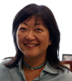
Shared Data Highlights
The Research Volunteers Protocol
83 (and counting) healthy volunteers scanned at NIMH + clinical screening and phenotyping
Available on the NIMH Data Archive (NDA) May 15
Joyce Chung

Slide 19
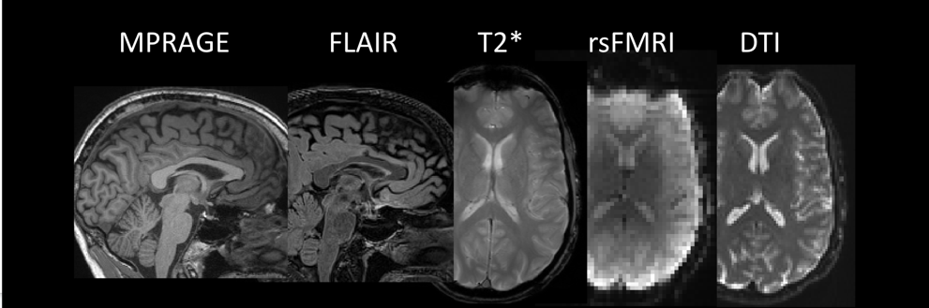
Better clinical scans & shared data
Sequences developed for this Research Volunteers protocol (based on ADNI/ABCD) can be used instead of the clinical scan
Investigators can now use Director’s Reserve scan time to conduct these clinical scans, provided they have broad sharing in their protocol
The DSST will manage anonymization and sharing of these scans
Thanks to Vinai Roopchansingh
& John Butman

Slide 20

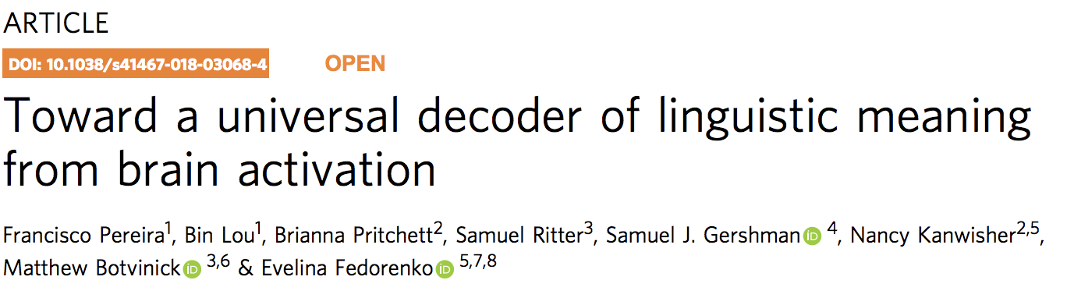
Shared Data Highlights
IARPA Competition: Decode sentences from fMRI
Three separate "semantic mapping" datasets
fMRI data for 180 concepts, using three different types of stimuli: sentences, pictures, word clouds
18 subjects, ~150 hrs of fMRI task data
Initial release available now: http://nido.nimh.nih.gov
Help with:
Consent, protocol language, & IRP issues
Choosing a repository
Standardizing and data formatting

Slide 21
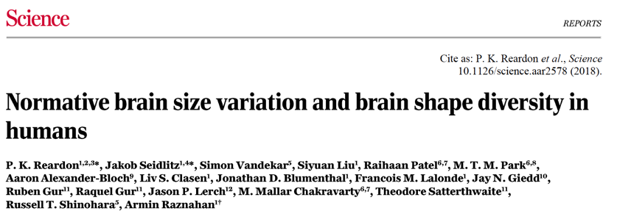
Shared Data Highlight
The NIMH IRP longitudinal MRI Study of Normal Development 1990-2010
High impact, historic dataset
1,531 longitudinal, structural MRI scans on 792 subjects age 5-25 years
Available on the NDA May 15

Slide 22
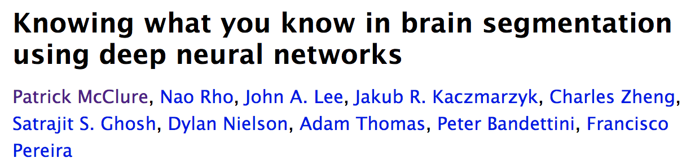
Curated Data
Dataset | Size | Age | Comment
Human Connectome Project (HCP) | 1500 | 22-35 | 3 hrs,high res, twins &siblings
Open fMRI | > 3,000 | Varies | Many different studies/sites
Functional Connectomes Project (FCON 1000) | > 1,500 | 19-80 | Collected across 33 different sites
Southwest U. Longitudinal Imaging Multimodal (SLIM) | > 1,000 | 18-22 | Longitudinal, rich behavioral
Consortium for Reliability and Reproducabilty (CoRR) | > 1000 | 5-77 | focus reliability and reproducibility
Southwest University Adult Lifespan Dataset (SALD) | > 400 | 19-80 | Wide age range, multimodal
Child Mind Inst. Healthy Brain Network (CMI HBN) | > 700 | 5-21 | Rich phenotyping
Autism Brain Imaging Data Exchange (ABIDE) | > 2000 | 7-21 | Approximately 50% individuals with ASD
ADHD-200 | > 700 | 7-26 | Approximately 36% individuals with ADHD
UK Biobank | < 35,000 | 40-69 | Eventually 100,000 subjects with genetics
NIMH/NHGRI Data Sharing Project | > 400 | 5-77 | Collected at on NIH Campus (Phil Shaw)
Adolescent Brain Cognitive Development (ABCD) | > 10,000 | 9-10 | rich phenotyping, multisite

Slide 23
Curated Data
Dataset | Size | Age | Comment
Human Connectome Project (HCP) | 1500 | 22-35 | 3 hrs,high res, twins &siblings
Open fMRI | > 3,000 | Varies | Many different studies/sites
Functional Connectomes Project (FCON 1000) | > 1,500 | 19-80 | Collected across 33 different sites
Southwest U. Longitudinal Imaging Multimodal (SLIM) | > 1,000 | 18-22 | Longitudinal, rich behavioral
Consortium for Reliability and Reproducabilty (CoRR) | > 1000 | 5-77 | focus reliability and reproducibility
Southwest University Adult Lifespan Dataset (SALD) | > 400 | 19-80 | Wide age range, multimodal
Child Mind Inst. Healthy Brain Network (CMI HBN) | > 700 | 5-21 | Rich phenotyping
Autism Brain Imaging Data Exchange (ABIDE) | > 2000 | 7-21 | Approximately 50% individuals with ASD
ADHD-200 | > 700 | 7-26 | Approximately 36% individuals with ADHD
UK Biobank | < 35,000 | 40-69 | Eventually 100,000 subjects with genetics
NIMH/NHGRI Data Sharing Project | > 400 | 5-77 | Collected at on NIH Campus (Phil Shaw)
Adolescent Brain Cognitive Development (ABCD) | > 10,000 | 9-10 | rich phenotyping, multisite
Datasets available on the NIH High Performance Cluster in /data/DSST or /data/DSST_dua

Slide 24
Curated Data Highlights
UK Biobank
High quality MRI on 35,000 subjects (37-73 years) + deep phenotyping
Whole Exome Sequencing on 50,000 subjects
Available now on the NIH Compute Cluster (Data Use Agreement required)

Slide 25
Curated Data Highlights
Single Individual volunteer for Multiple Observations across Networks (SIMON) MRI dataset from INDI
One ambidextrous healthy male aged between 29-46 years old, scanned in 73 sessions at multiple sites and with various scanner models over 17 years
Freely available without DUA

Slide 26
Questions
Why do we need a Data Science & Sharing Team?
What does the Data Science & Sharing Team do?
Sharing & Curating data
Training
Collaborative projects and grants
How can you make your science more reproducible?

Slide 27

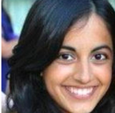
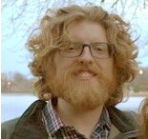

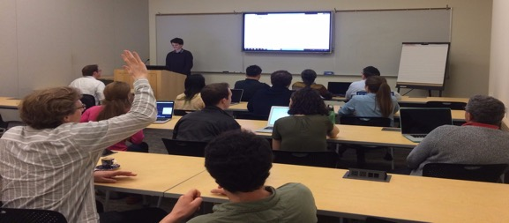
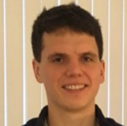
Training on working with large datasets
Short courses & multiday workshops on reproducible computing tools
Automation with the Unix shell and High Performance Computing
Basic coding skills: R, Python, Juypter Notebooks, NiPype
Version Control and code sharing: git & github
Increasing reproducibility with containerization
Also funded for 2019
Two teams a NCBI biohack
Hackathons
Dylan Nielson & Bob Cox
One-on-one or small group sessions
Mark Histed
John Lee
Approx. 15 courses given or hosted to date, see http://cmn.nimh.nih.gov/dsst for a full listing

Slide 28
Questions
Why do we need a Data Science & Sharing Team?
What does the Data Science & Sharing Team do?
Sharing & Curating data
Training
Collaborative projects and grants
How can you make your science more reproducible?

Slide 29
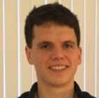
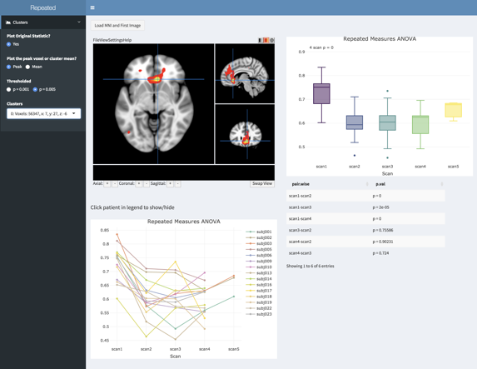
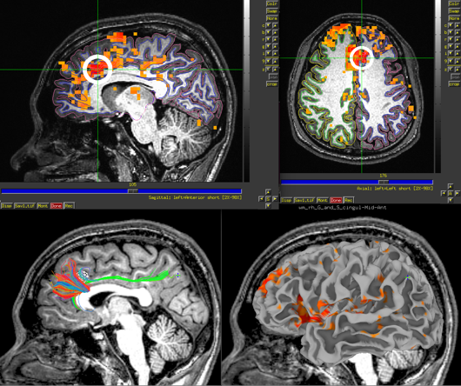
BRAIN Grants
Expanding Reproducibility, Quality Control, and Visualization in AFNI
Very strong review & high score
Created new position on the AFNI Team
Dylan Nielson Robert Cox
a
b
c
e
d

Slide 30

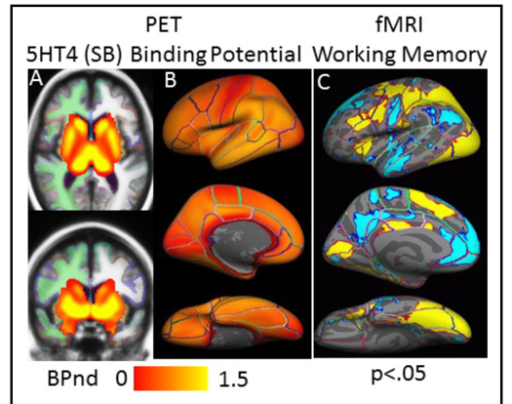
BRAIN Grants
A standards-compliant PET repository
Will fund the creation of a PET validator tool (BIDS)
Create a new position within the NIMH IRP for PET data curation
PET receptor atlases
Dylan Nielson. Robert Innis
Russ Poldrack & Chris Gorgolewski
Stanford Center for Reproducible Neuroscience
Doug Greve

Slide 31

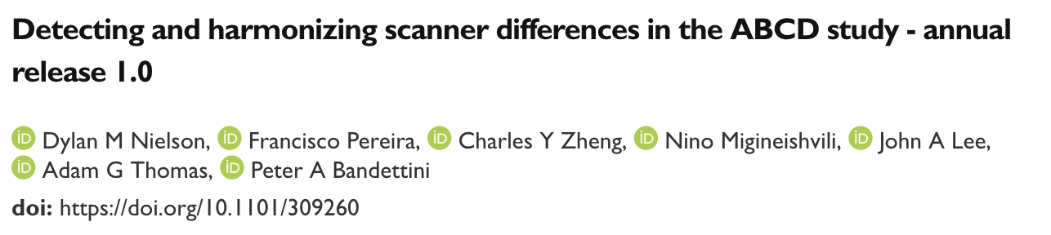

Collaborative Projects: Harmonizing across scanners
Long standing issue in the NIMH IRP
Question from NIMH Extramural
Pros & cons of multiple scanners
ABCD: 21 very different scanners
COMBAT method allow this variance to be mostly removed, but at a cost
Linda Brady & Michele Ferrante

Slide 32
Questions
Why do we need a Data Science & Sharing Team?
What does the Data Science & Sharing Team do?
Sharing & Curating data
Training
Collaborative projects and grants
How can you make your science more reproducible?

Slide 33
Questions
Why do we need a Data Science & Sharing Team?
What does the Data Science & Sharing Team do?
Sharing & Curating data
Training
Collaborative projects and grants
How can you make your science more reproducible?

Slide 34
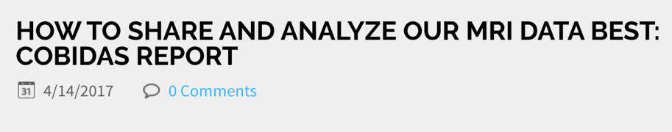

How can we help you make your science more reproducible
Data sharing
Reporting guidelines (e.g. COBIDAS & EQUATOR) for publication and review

Slide 35
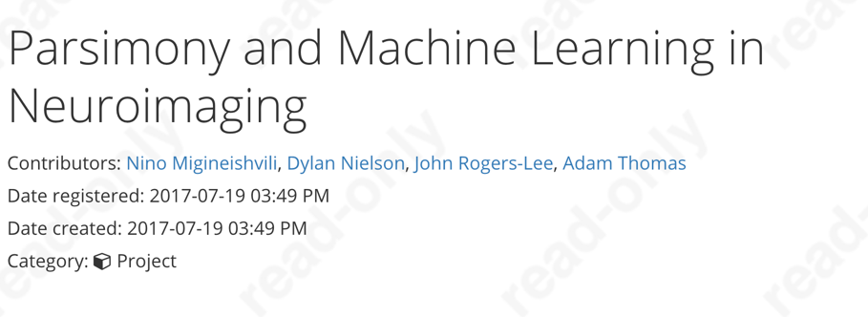


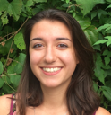

How can we help you make your science more reproducible
Data sharing
Reporting guidelines (COBIDAS & EQUATOR)
Replicating with independent data
Pre-registration
Code sharing

Slide 36
Take homes
Science can and should be more reproducible, and we’re making progress
The Data Science & Sharing Team is working to enhance reproducibility within the IRP through data sharing, training, and collaborative projects
You can make your science more reproducible with simple steps. Our team is here to help!

Slide 37
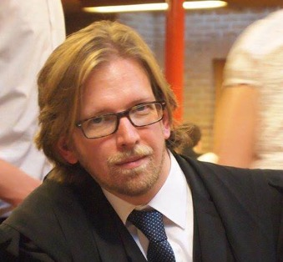
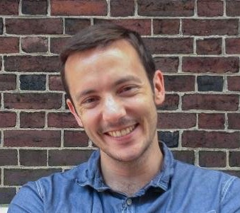
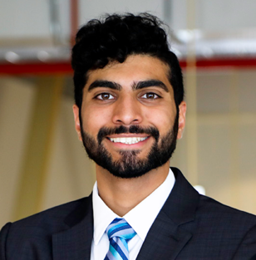
Summary
Data Science & Sharing Team
Adam Thomas Dylan Nielson
Travis Riddle
Mar 25th
Nikhil Goyal
Fall 2019
NIMHDSST@mail.nih.gov
http://cmn.nimh.nih.gov/dsst (includes link to slides)
Building 10, Room 3D39 (DSST, MLT, SIO + good coffee & snacks)

Slide 38
Thanks!

